Slide 1
Improving Community Adult Nutrition (I-CAN) e-learning
The I-CAN e-learning training package has been designed to support carers and staff looking after adult patients aged 18 years and over living in community settings to support them with their nutritional care.
Please ensure you have read the ‘Introduction to I-CAN e-learning’ document for more information on the topics covered and learning outcomes.
We hope you find this training package useful.
Leicestershire
Nutrition & Dietetic Service

Slide 2
I-CAN - Introduction to Malnutrition
Please DO NOT save or share this PowerPoint to avoid circulation of out-of-date information

Slide 3
Aims:
To highlight national standards in relation to nutrition and hydration
Define a balanced diet
Define malnutrition
Highlight causes and consequences of malnutrition in the form of undernutrition
How to identify malnutrition

Slide 4
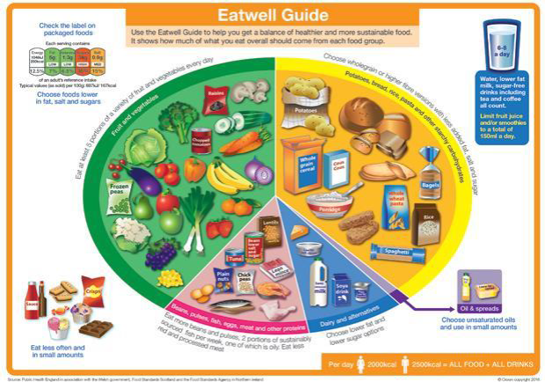
What is a general balanced diet?
The Eatwell Guide shows the range of food groups to include to achieve a healthy, balanced and varied diet across each day.
This includes sources of energy, protein, healthy fats, vitamins and minerals, alongside fluid and fibre.
This approach is appropriate for individuals who are aiming for maintaining weight within the healthy BMI range which will be discussed in further detail during this training.
Click here to find out more information on each food group

Slide 5
What is Malnutrition?
Malnutrition is a serious condition that happens when your diet does not contain the right amount of nutrients. It means "poor nutrition" and can refer to:
- undernutrition – not getting enough nutrients
- overnutrition – getting more nutrients than needed
This training focuses on the management of undernutrition (NHS Choices)
The cost of malnutrition to the health and social care systems was around £19.6 billion in England in 2011–12 (M Elia 2015)
“Treating someone who is malnourished is two to three times more expensive than for someone who is not malnourished” (Malnutrition Taskforce)
At any point in time more than 3 million people in the UK are at risk of malnutrition, most (approximately 93%) live in the community. High risk groups include older people, those recently discharged from hospital, those with chronic disease, progressive neurological disease, acute illness, frailty, undergoing rehabilitation or end of life/palliative care (MalnutritionPathway.co.uk)
The aim of nutritional screening is to identify residents at risk of malnutrition and those who are already malnourished

Slide 6
Key national standards to guide you with preventing and treating malnutrition within your role:
Care Quality Commission (CQC), sets standards which they expect all care providers to comply with:
The Health & Social Care Act 2008 ‘CQC Regulation 14’: Meeting nutritional and hydration needs – The nutritional and hydration needs of service users must be met.
NICE: Nutrition support for adults Guidelines CG32.
People in care homes should be screened on admission and when there is clinical concern.
Clinical concern includes, for example, unintentional weight loss, fragile skin, poor wound healing, apathy, wasted muscles, poor appetite, altered taste sensation, impaired swallowing, altered bowel habit, loose fitting clothes or prolonged intercurrent illness.
Screening should assess body mass index (BMI) and percentage unintentional weight loss and should also consider the time over which nutrient intake has been unintentionally reduced and/or the likelihood of future impaired nutrient intake.
The Malnutrition Universal Screening Tool (MUST), for example, may be used to do this.
Notes:
THE HEALTH AND SOCIAL CARE ACT –
‘People must have their nutritional needs assessed and food must be provided to meet those needs. This includes where people are prescribed nutritional supplements and/or parenteral nutrition. People's preferences, religious and cultural backgrounds must be taken into account when providing food and drink.’ CQC can prosecute for a breach of this regulation’

Slide 7
Causes of malnutrition – Click boxes to reveal answers
Poor dentition
Poor swallow
Medical conditions eg cancer, COPD, infections, pain
Mental health problems e.g. depression, anxiety
Cognitive impairment e.g. dementia, age-related
Inability to feed self e.g. poor dexterity
Impaired digestion and absorption
Nutrient losses e.g. chronic diarrhoea, stoma losses
Increased requirements e.g. pacing++
Drugs side effects
Reduced appetite

Slide 8
Effects of under-nutrition
Increased risk of falls
Exhaustion and lethargy
Psychology –
depression & apathy
Poor lung function
Immunity – Increased risk of infection
Changes in liver function
Decreased Cardiac output
Impaired wound healing
Impaired kidney function
Impaired gut
integrity and immunity
Hypothermia
Low mood
Reduced quality of life
Lack of appetite
Loss of strength
Notes:
Overall effect – increased morbidity and increased mortality.

Slide 9
How to identify signs of malnutrition?
unintentional weight loss
fragile skin and poor wound healing
disinterest in food and fluids
wasted muscles
poor appetite
impaired swallowing
altered bowel habit
loose fitting clothes, jewelry and dentures
prolonged inter-current illness

Slide 10
Summary
A general balanced and varied diet for adults is important for optimal health and wellbeing.
Malnutrition is a serious condition that happens when your diet does not contain the right amount of nutrients.
We are bound by legislation and standards to help prevent / treat malnutrition.
Malnutrition can have a negative impact on patients’ health affecting both mental and physical function.
There are many signs of malnutrition that are important to be aware of.

