Slide 1

Improving Community Adult Nutrition (I-CAN) e-learning
RECAP: In Topic 1 Introduction To Malnutrition we covered:
A general balanced and varied diet for adults is important for optimal health and wellbeing.
Malnutrition is a serious condition that happens when your diet does not contain the right amount of nutrients.
We are bound by legislation and standards to help prevent / treat malnutrition.
Malnutrition can have a negative impact on patients’ health affecting both mental and physical function.
There are many signs of malnutrition that are important to be aware of.
Leicestershire
Nutrition & Dietetic Service

Slide 2

I-CAN - How to screen for Malnutrition
Leicestershire
Nutrition & Dietetic Service

Slide 3

Aims:
Learning how to calculate Body Mass Index (BMI)
Learning how to calculate percentage unplanned weight loss score
Being aware of alternative measurements including mid upper arm circumference (MUAC) and ulna length
Learning how to complete a Malnutrition Universal Screening Tool (MUST) and obtain overall MUST score

Slide 4
Overview
Now you have a good understanding of malnutrition, this power point will cover how to screen for malnutrition using the Malnutrition Universal Screening Tool (MUST) and identify a patients MUST score.
It will take you through how to complete calculations needed for this type of screening including how to work out body mass index (BMI) and percentage weight loss.
We have included explanations of how to use tools that are included in the MUST screening pack to aid these calculations.
When it is not possible to obtain a weight or height there are alternative methods that can be used.

Slide 5
Screening for Malnutrition
Screening for malnutrition should be completed via a validated screen tool. An example of this is the ‘Malnutrition universal screen tool’. (MUST)
The following slides will explain how the MUST Tool should be completed.
When should MUST be used?
All patients should be screened on admission to care setting i.e. hospital, care home.
This should be repeated at monthly intervals, or sooner if you have concerns.

Slide 6
Recording an accurate height and weight
Tips for accurate weight:
Use an appropriate scale. If using hoist, ensure suitable sling size is used.
Ensure body weight is not being supported by an object, e.g. walking stick, or touching a fixed object, e.g. wall.
Apply brakes (if required).
Wheelchair scales- ensure feet are not touching the floor. Weight of wheelchair needs to be considered.
Empty catheter or stoma bags.
If there is a significant change in weight, to re-weigh the resident.
Make a note of factors that could affect weight, e.g. oedema, ascites, amputation and plaster cast.
Accurate height:
Please check height on admission using stadiometer (if available).
If no stadiometer available, please use ulna length (details to follow)
If weighing a resident is not an option, mid-upper arm circumference (MUAC) can be used instead (details to follow)
MUST scores are calculated using heights and weights; therefore, these measurements must be accurate to ensure a correct score is calculated.
Notes:
Mention Screening is based on Height and weights –therefore these need to be accurate**
Appropriate scale could be; standing, chair, wheelchair or hoist.
https://nnng.org.uk/wp-content/uploads/2021/07/Accurate-Body-Weight-Measurement-GPG-Final-draft-Feb17.pdf.
Demo how to measure and accurate weight using care home scales.
We will take them through how to do ulna length and MUAC next.

Slide 7
‘MUST’
MUST is a simple 5 step validated tool for use by all care workers in all care settings:
Step 2
Calculate unplanned weight loss in past 3-6 months to obtain weight loss score
Step 4
Obtain overall risk of malnutrition score (add step 1, 2 and 3 score together)
Step 5
This will determine management guidelines
Step 3
Step 1
Measure height and weight to calculate BMI to obtain BMI score
Consider acute disease effect score

Slide 8
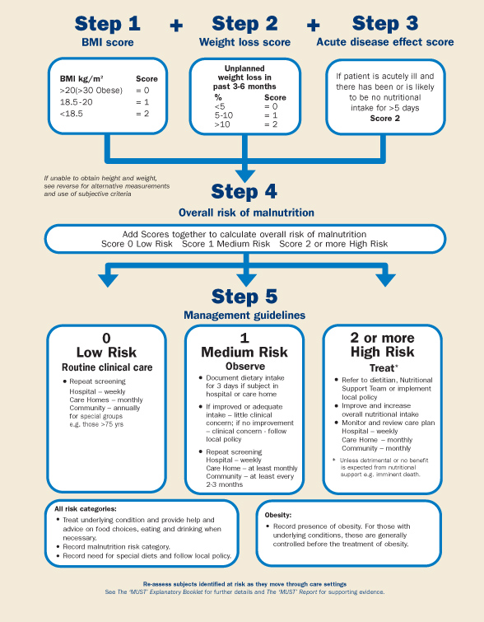
Malnutrition Universal Screening
Tool
(‘MUST’)
Please familiarise yourself with the MUST flowchart which will be discussed in detail over the next slides
Please click picture to link to website for a larger image
Notes:
And here it is.
Not complex,
Not overwrought with detail.
But a simple 5-step screening tool.
Before we look into how MUST can be used practically, I’ll just summarise some key benefits.

Slide 9
Ethel, our fictional patient, will be used as an example throughout this presentation to help you work through the MUST calculations:
‘ Ethel is a lovely 79 year old lady currently residing in a residential care home. She enjoys eating her meals with others in the dining area and reading books in the day lounge with her friends and family. Ethel tends to go for a short walk after lunch in the communal gardens and has a good sense of humour.’
Her height is 1.52m
Her current weight is 60kg, previous weight 4 months ago: 63kg

Slide 10
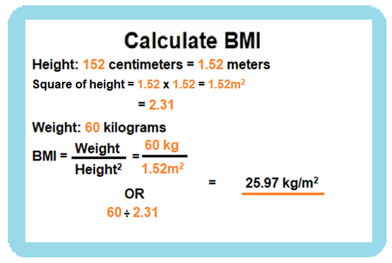
Step 1:
How to calculate
Body Mass Index in order to work out
BMI score :
Please see equation below which uses Ethel’s current weight and height information to calculate her BMI. This will then help to identify her BMI score for Step 1.

Slide 11
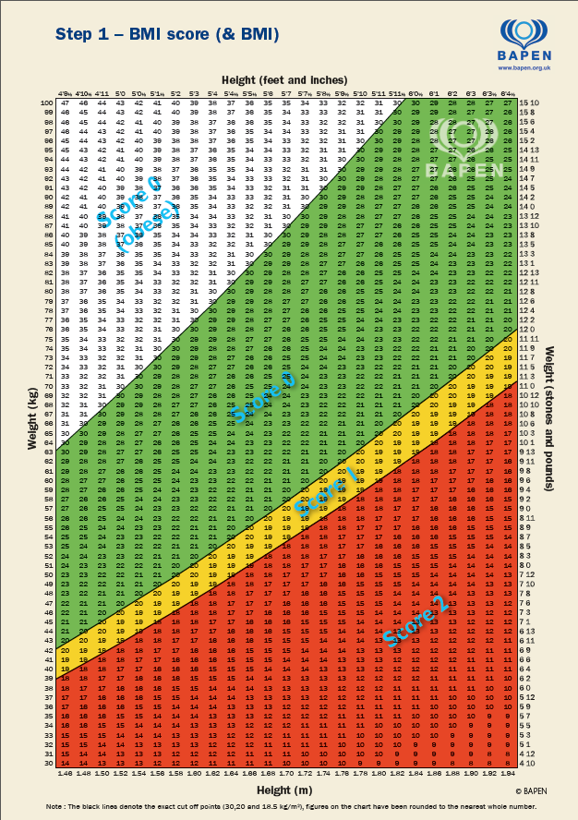
Alternatively, if you do not have access to a calculator you can refer to BAPEN BMI Score sheet to obtain BMI. This can be done by:
Identify weight on vertical line (60kg)
Identify height on horizontal line (1.52m)
Follow the lines horizontally and vertically to identify where they meet ( . Icon) This is Ethel’s BMI

Slide 12
How to interpret
BMI Score
BMI Score
Above: 20 kg/m² 0
Between:18.5-20 kg/m² 1
Below:18.5 kg/m² 2
Ethel’s BMI (slide 8) is 25.97kg/m² and will therefore give a score of 0 as BMI is above 20kg/m²
Keep a note of this score from Step 1 as you will refer to it later when adding up the total score for Step 4

Slide 13
FAQ:
What to do if you are not able to weigh the patient?
Consider visual / subjective judgement i.e. looser fitting clothes / jewellery, poorly fitting dentures which may indicate weight loss.
An alternative measurement is mid upper arm circumference (MUAC).
The above technique involve measuring the mid-point of the upper arm with a tape measure. It is a useful measure when a person cannot be weighed or if their weight is not likely to be a true reflection of the persons’ actual weight, e.g. if the patient has oedema or ascites (fluid build up causing swelling).
The use of MUAC provides a general indication of BMI and is not designed to generate an actual score for use with ‘MUST’.

Slide 14
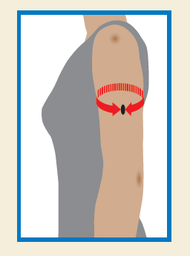
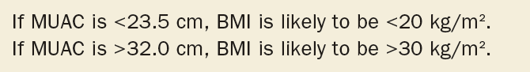
How to obtain a
MUAC
Please click the picture below to take you to the video of how to obtain a MUAC. This video has been sourced from ‘Focus on undernutrition’ via YouTube.
Please click for further written information on how to complete this measurement

Slide 15
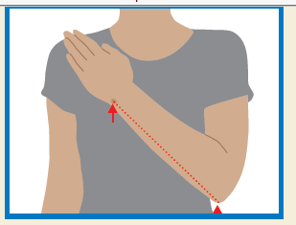
FAQ: What to do if you are unable to measure the patient's height?
Please click video link to view a short clip on how to obtain an ulna measurement. This video has been sourced from ‘Focus on undernutrition’ via YouTube.
Measuring someone's height can sometimes be difficult in some cases i.e. unable stand, poor posture.
If height cannot be measured often people will know their height. It is useful to ask what their height is. If it is felt this may not be accurate, please consider using the following measurement.
Recommended alternative measurement e.g. ulna length can be used.

Slide 16
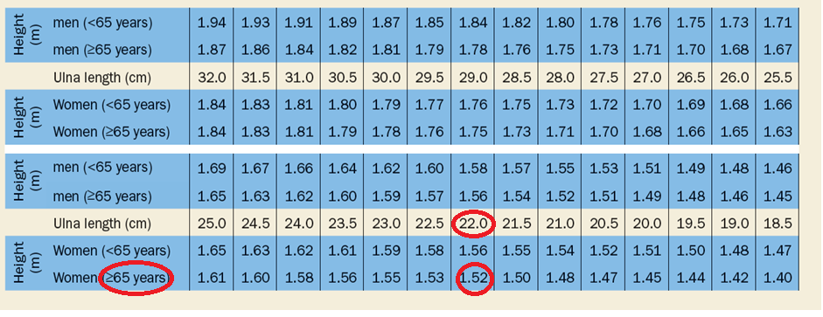
Please see the following table to convert your ulna length into an estimated height.
E.g.: Ethel’s ulna length of 22cm for a women over 65 years old would equate to 1.52cm.
A larger version of this table can be viewed on the Bapen website

Slide 17
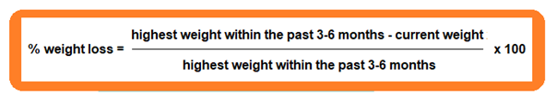
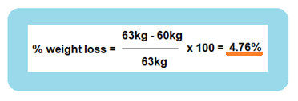
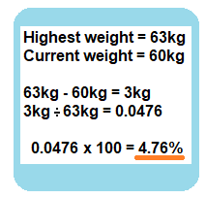
Step 2:
How to calculate unintentional weight loss score:
Unintentional weight loss is when you lose weight without intentionally changing your diet or exercise routine.
This can be an early sign of malnutrition.
The following equation will explain how to calculate percentage of unplanned weight loss in order to obtain weight loss score for Step 2
This calculation shows us that Ethel has lost 3kg (63kg – 60kg =3kg) over the last 3-6 months, therefore her unplanned weight loss is 4.76%

Slide 18
        Score
<5% body weight: 0 (normal variation)
5-10% body weight: 1 (concern)
>10% body weight: 2 (significant)
How to interpret percentage weight loss score
Keep a note of this score from Step 2 as you will refer to it later when adding up the total score for Step 4
Ethel’s weight loss of 3kg (slide 15) equated to less than 5% and therefore the score for step 2 is 0

Slide 19
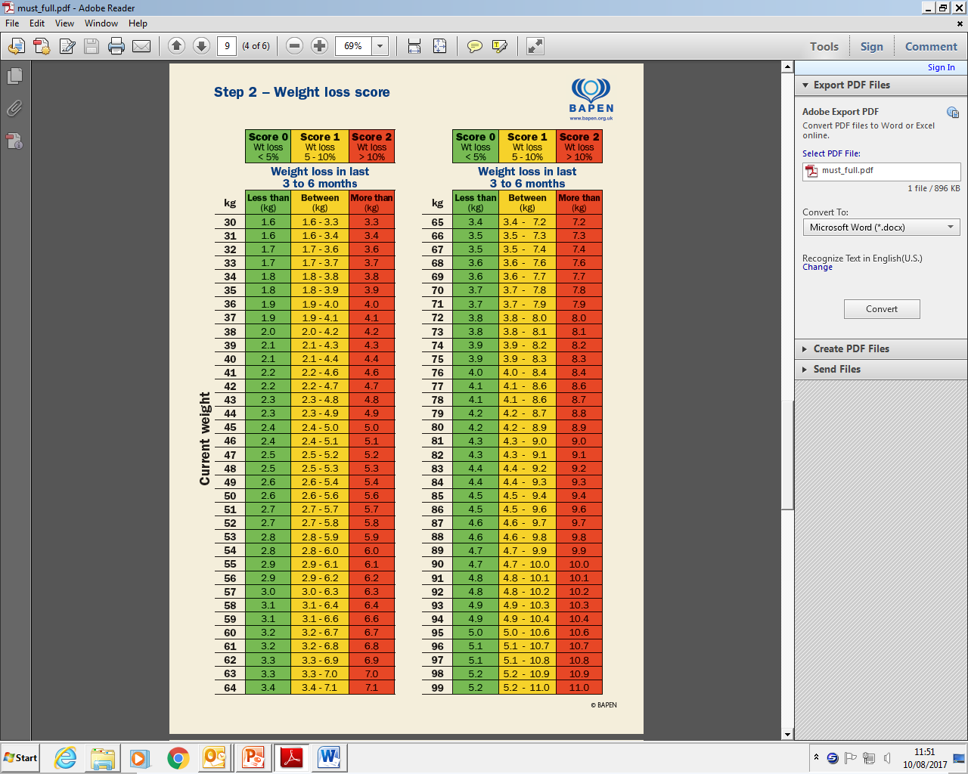
Alternatively, this BAPEN Weight loss score sheet can be used to identify unintentional weight loss score. Please follow the steps below:
1. Identify current weight e.g. 60kg
2. Deduct current weight from the heaviest previous weight within the last 3-6 months.
E.g. Ethel’s previous weight was 63kg therefore 63-60=3kg .
Find correlating weight loss column where this figure falls.
3. Unintentional weight loss score will be determined by the column that the weight loss in kg falls in. E.g. for Ethel, the score would be Score 0 as weight loss of 3kg is in the green column which equates to <5% total weight loss.

Slide 20
Important reminder:
Please be mindful that there are some situations where a decrease in body weight would not be classified as unintentional weight loss i.e. patient actively trying to lose weight or improve their diet, a reduction in oedema, having an amputation and error in accurately recording or measuring weight e.g. swapping from standing to sitting scales.

Slide 21
Step 3:
Acute disease effect (ADE)
ADE is considered for patients who are acutely ill and have had or are likely to have no nutritional intake for more than 5 days
An acutely ill patient can be defined as critically ill; having swallowing difficulties e.g. after stroke, head injuries, or undergoing gastrointestinal surgery
ADE is most likely applicable to patients in hospital
Add 2 to overall score if ADE is appropriate
Ethel is not acutely ill and is not in hospital therefore our score for step 3 is Score 0
Keep a note of this score from Step 3 as you will refer to it later when adding up the total score for Step 4

Slide 22
Quick reminder:
So far you have obtained the following scores:
Step 1 BMI Score (as shown on slide 10) - Score 0
Step 2 Unintentional weight loss score (as shown in slide 16) - Score 0
Step 3 Acute disease effect score (as shown on slide 19) – Score 0
You will now use these to calculate the overall score for Step 4 Overall risk of malnutrition

Slide 23
‘Malnutrition Universal Screening Tool’ (‘MUST’)
Taking into account the scores you have obtained for Ethel for Step 1 + Step 2 + Step 3, what do you think is the score for step 4 (overall risk for malnutrition) for Ethel?
Step 4:
Overall risk of
malnutrition
Step 4 Overall risk of Malnutrition MUST score is 0
Please click picture for link to website
Notes:
And here it is.
Not complex,
Not overwrought with detail.
But a simple 5-step screening tool.
Before we look into how MUST can be used practically, I’ll just summarise some key benefits.

Slide 24
Step 5: Management guidelines will be covered in the next PowerPoint

Slide 25
SUMMARY:
You have now learnt how to to complete a Malnutrition Universal Screening Tool (MUST) and obtain overall MUST score. This includes
Step 2
Calculate % unplanned weight loss in past 3-6 months to obtain weight loss score.
Step 4
Obtain overall risk of malnutrition score (add step 1, 2 and 3 score together)
Step 5
This will determine management guidelines
Step 3
Step 1
Consider acute disease effect score
You have also learnt how to obtain alternative measurements such as ulna for height and MUAC for estimate of BMI.
You are also aware of BAPEN reference sheets as an alternative method for working out BMI score
You are also aware of BAPEN reference sheets as an alternative method for working out weight loss score
Measure height and weight to calculate BMI to obtain BMI score.

Slide 26
Case study
(click answer boxes to reveal answers)
If your answers are incorrect please refer back to previous slides for guidance on steps 1-4 of the MUST screening tool
Knowledge Check:
Ethel is 79
Her weight is 60kg
Her height is 1.52m
Four months ago her weight was 63kg
Ethel has had a cold for the past week and has been eating half of her meals for the past 3 days
Step 1 :What is her BMI? 25.97kg/m²
Step 2: How much weight has she lost in the last 4 months?
3kg / 4.76%
Step 3: Is Ethel acutely unwell and has been or likely to have little of no nutritional intake for 5 days?
No
Step 4 :What is her overall MUST score? 0
Answer
Answer
Answer
Answer

