Slide 1

Improving Community Adult Nutrition (I-CAN) e-learning
RECAP: In Topic 2 How to screen for Malnutrition we covered:
The malnutrition screening tool and how to complete each step
Step 2
Calculate % unplanned weight loss in past 3-6 months to obtain weight loss score.
Step 4
Obtain overall risk of malnutrition score (add step 1, 2 and 3 score together)
Step 5
This will determine management guidelines
Step 3
Step 1
Measure height and weight to calculate BMI to obtain BMI score.
Consider acute disease effect score
How to obtain alternative measurements such as ulna for height and MUAC for estimate of BMI.
BAPEN reference sheets as an alternative method for working out BMI score
BAPEN reference sheets as an alternative method for working out weight loss score
Leicestershire
Nutrition & Dietetic Service

Slide 2

I-CAN - How to create a
Nutritional Care Plan

Slide 3

Aims:
Learning how to create an appropriate nutritional care plan based on MUST score
Examples of patient centred nutritional aims that could be used
Appropriate actions to take in line with MUST score

Slide 4
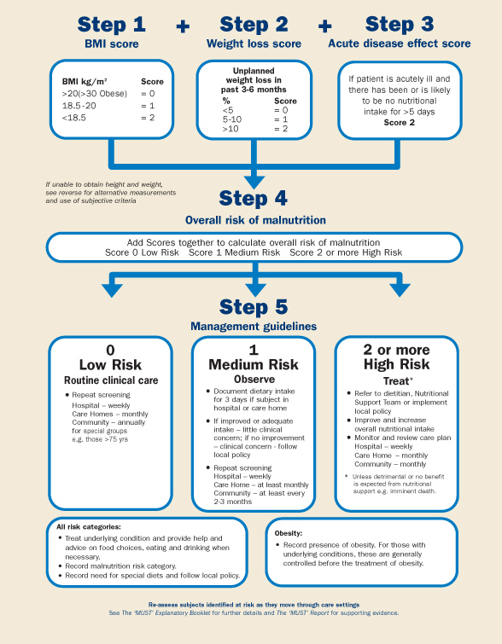
Step 5:
Management plan
In the previous PowerPoint you have learnt how to screen for malnutrition and obtain an overall MUST score. It is important the MUST score is acted upon and a nutritional care plan based on this score is in place to manage the risk of malnutrition.

Slide 5
How to create a nutritional care plan
This should be based on the MUST score
Set nutritional aims (there should be a clear outcome or end-point for the action)
State agreed plan to be implemented
State monitoring to be carried out
Aims should be reviewed at the agreed timescales and action taken depending on whether they are being achieved or not
Management plans included in this guidance are based on our local guidelines: LLR APC Managing Malnutrition in Adults in Primary Care Guidelines

Slide 6
Aims may include:
Maintain weight
Gain a set amount of weight
Improve nutritional intake to support:
Skin health
Post surgery/infection
Maintain general health and wellbeing
Minimise further weight loss
Achieve adequate fluid intake
To achieve the aim we have to create a nutritional care plan.
This will be different depending on the MUST score.

Slide 7
Management plan: Low Risk
Ethel’s MUST score is 0, therefore low risk management plan should be put in place
If nutrition score is “low risk”:
Encourage a well balanced diet
Check weight monthly
Repeat MUST screening tool monthly or sooner if any concerns
MUST score
0

Slide 8
Management plan: Medium Risk
MUST score
1
If nutrition score is “Medium risk”:
Document dietary intake for 3 days
If eating ¾ portion of all meals and puddings, repeat screening at least monthly
If eating less than ¾ portion of all meals and puddings, there may be clinical concern therefore:
Set nutritional aim
Implement food first and fortification advice (covered in next presentation) to improve and increase overall nutritional intake
Offer home-made or over the counter milkshakes/nourishing drinks
Monitor and review care plan regularly (covered in next presentation)
Repeat MUST screening tool in 4 weeks or earlier if appropriate

Slide 9
Management Plan: High Risk
MUST SCORE 2+
If nutrition score is “High risk”:
Set nutritional aim
Implement food first and fortification advice as for medium risk
Offer home-made or over the counter milkshakes/nourishing drinks
If no weight gain and/or MUST score increased after 4 weeks, ask GP to refer to LLR APC Managing Malnutrition in Adults in Primary Care Guidelines
Repeat MUST screening at least monthly

Slide 10
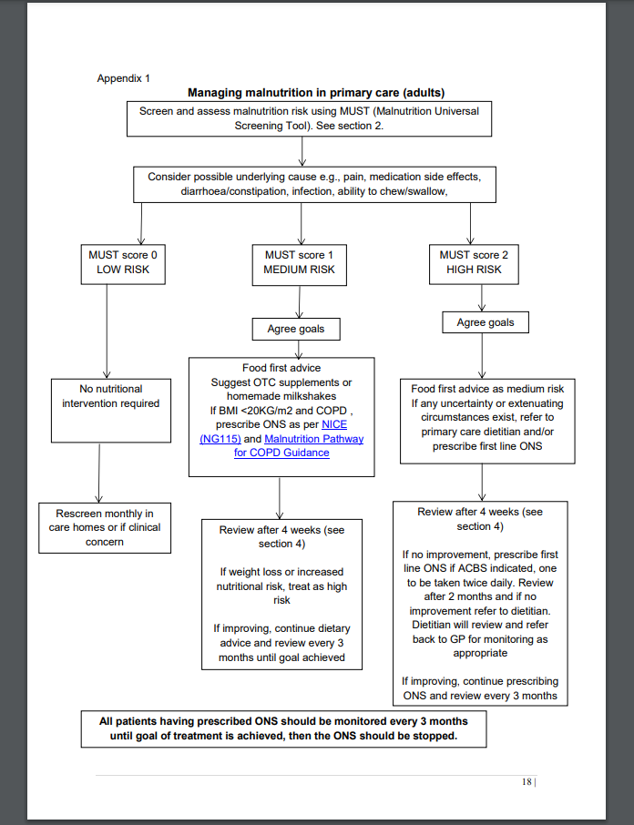
Managing Malnutrition Flowchart
Please see useful flowchart for a summary of the MUST Score Management plans based on local guidance.
This is page 18-APPENDIX 1 from LLR APC Managing Malnutrition in Adults in Primary Care Guidelines.
Please click on the above link to take you to the flowchart

Slide 11
Summary
You should now be familiar with how to create and implement a nutritional care plan based on overall MUST score.
It is worth noting that in addition to the MUST score, health care professionals should always use their professional judgement.
Consider patient’s overall health status and whether suggested care plan is appropriate and in line with their overall medical management plan.
If unsure always check with key health professionals involved in the patient’s care.
Always ensure that the nutritional care plan is in line with the nutritional aim.

Slide 12
Knowledge Check:
Ethel is 79 years old. She is currently staying in a residential care home and has recently had a chest infection. She is eating less than half portions of her usual meals and puddings. She has lost further weight and now has a MUST score of 2.
1. What is your nutritional aim?
2. Which management plan would you implement?
3. If Ethel hasn’t gained any weight after 4 weeks or her MUST score has increased, who should you refer the patient to?
1. An appropriate aim may include:
To minimise further weight loss
OR to improve oral intake post infection
2. The correct management plan would be for ‘High Risk’ as her overall MUST score is 2
3. Ask GP to refer to LLR APC Managing Malnutrition in Adults in Primary Care Guidelines and continue to repeat MUST screening at least monthly

