Slide 1

Improving Community Adult Nutrition (I-CAN) e-learning
RECAP: In Topic 2 How to screen for Malnutrition we covered:
The malnutrition screening tool and how to complete each step
Step 2
Calculate % unplanned weight loss in past 3-6 months to obtain weight loss score.
Step 4
Obtain overall risk of malnutrition score (add step 1, 2 and 3 score together)
Step 5
This will determine management guidelines
Step 3
Step 1
Measure height and weight to calculate BMI to obtain BMI score.
Consider acute disease effect score
How to obtain alternative measurements such as ulna for height and MUAC for estimate of BMI.
BAPEN reference sheets as an alternative method for working out BMI score
BAPEN reference sheets as an alternative method for working out weight loss score
Leicestershire
Nutrition & Dietetic Service

Slide 2

I-CAN - How to create a
Nutritional Care Plan
Leicestershire
Nutrition & Dietetic Service

Slide 3

Aims:
Learning how to create an appropriate nutritional care plan based on MUST score
Examples of patient centred treatment goals that could be used
Appropriate actions to take in line with MUST score
  Please note: Details of how to implement these actions will be covered in the next topic

Slide 4
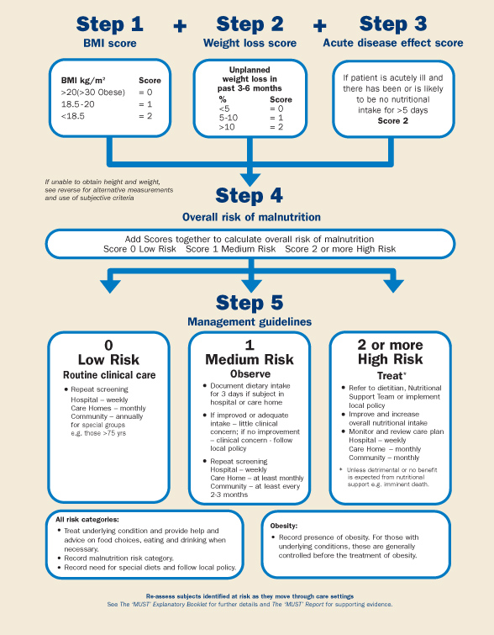
Step 5:
Management plan
In the previous PowerPoint you have learnt how to screen for malnutrition and obtain an overall MUST score. It is important the MUST score is acted upon and a nutritional care plan based on this score is in place to manage the risk of malnutrition.

Slide 5
How to create a nutritional care plan
This should be based on the MUST score
Set treatment goal (there should be a clear outcome or end-point for the action)
State agreed plan to be implemented
State monitoring to be carried out
Aims should be reviewed at the agreed timescales and action taken depending on whether they are being achieved or not
Management plans included in this guidance are based on our local guidelines for care homes: Oral Nutritional Supplement (ONS) Replacement In Care Homes - Leicestershire Social Care Development Group

Slide 6
Treatment goals may include:
Maintain weight
Gain a set amount of weight
Improve nutritional intake to support:
Skin health
Post surgery/infection
Maintain general health and wellbeing
Minimise further weight loss
Achieve adequate fluid intake
To achieve the treatment goal, we have to create a nutritional care plan.
This will be different depending on the MUST score.

Slide 7
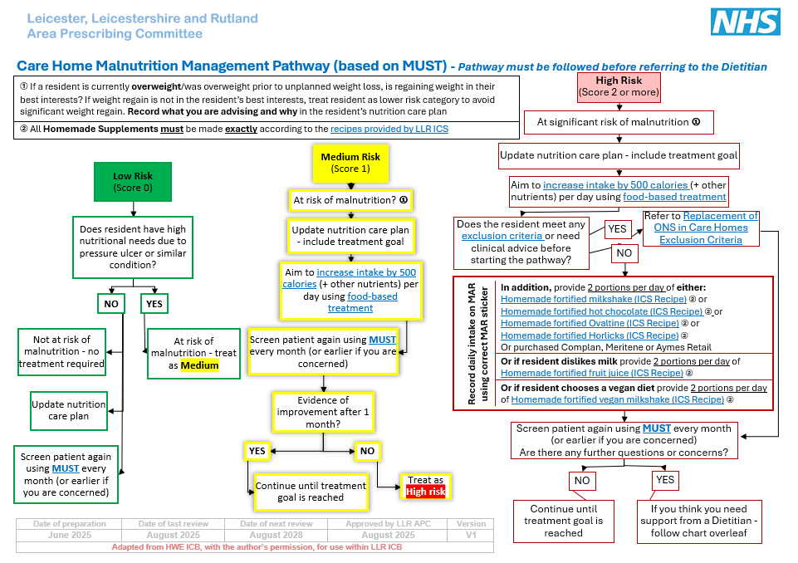
Care Home Malnutrition Management Pathway
Here is an overview of the new care home malnutrition management pathway.
This will be used to create a resident’s nutritional care plan, depending on what their MUST score is.
This is broken down into more detail on the following 3 slides.
More information about this scheme, can be found on the following websites:
LSCDG Providing care website APC website.

Slide 8
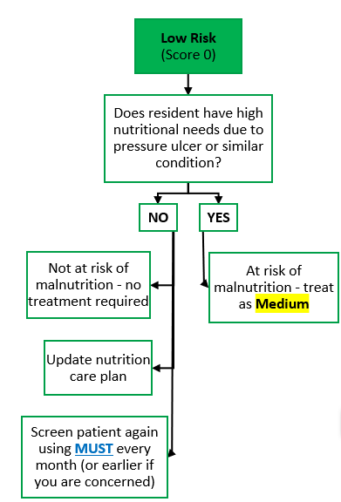
Management plan: Low Risk
MUST score
0
If nutrition score is “low risk”:
Encourage a well balanced diet
Check weight monthly
Repeat MUST screening tool monthly or sooner if any concerns

Slide 9
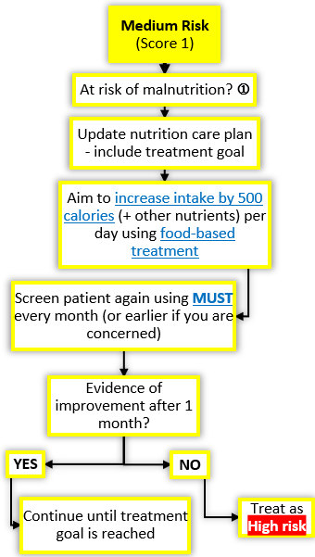
Management plan: Medium Risk
MUST score
1
If nutrition score is “Medium risk”:
Food charts are to be started
Update care plan and set nutritional aim
Increase intake by 500kcals daily, using Food based treatment
Monitor and review care plan regularly (covered in next topic)
Repeat MUST screening tool in 1 month or earlier if appropriate

Slide 10
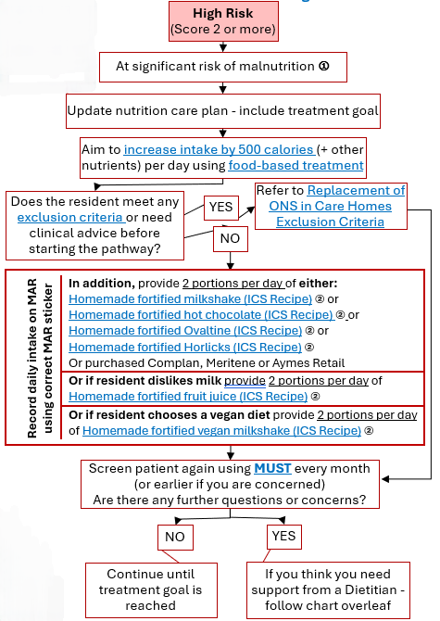
Management Plan: High Risk
MUST SCORE 2+
If nutrition score is “High risk”:
Food charts to be started/continued
Update Nutritional care plan (including a treatment goal)
Increase intake by 500kcals daily, using food-based treatment
If the resident does not meet any exclusion criteria, please commence 2 homemade supplements per day
Repeat MUST screening at least monthly
If your resident meets the exclusion criteria or referral to a Dietitian is indicated, please see topic 5.
Notes:
* If resident automatically MUST of 2 (not progressed from 0-1-2) then then food charts commenced

Slide 11
Summary
You should now be familiar with how to create and implement a nutritional care plan based on overall MUST score.
It is worth noting that in addition to the MUST score, health care professionals should always use their professional judgement.
Consider patient’s overall health status and whether suggested care plan is appropriate and in line with their overall medical management plan.
If unsure always check with key health professionals involved in the patient’s care.
Always ensure that the nutritional care plan is in line with the treatment goal.

Slide 12
Knowledge Check:
You might recall Ethel had a MUST score of 0 in our Topic 2 Powerpoint. Since then, Ethel has developed a chest infection. She is now eating ¾ of her meals and only one pudding a day. Weight is checked and she is now 58kg (further loss of 2kg).
BMI 25.1kg/m2 , 7.9% weight loss in 3 months
MUST = 1.
1. An appropriate treatment goal may include:
To minimise further weight loss
OR to improve oral intake post infection
1. What is your nutritional treatment goal?
2. Which management plan would you implement?
3. If Ethel hasn’t shown any sign of improvement after 4 weeks, what would be your next action?
2. The correct management plan would be for ‘Medium Risk’ as her overall MUST score is now 1
3. Treat as high risk of malnutrition, updating her care plan and commencing 2x homemade ONS replacement supplements using the ICS recipes (if exclusion criteria are not met)

