Slide 1

Improving Community Adult Nutrition (I-CAN) e-learning
RECAP: In Topic 3 How to create a nutritional care plan we covered:
How to create and implement a nutritional care plan based on overall MUST score.
Health care professionals should always use their professional judgement. Consider patient’s overall health status, whether suggested care plan is appropriate and is in line with their overall medical management plan. If unsure always check with key health professionals involved in the patient’s care.
Always ensure that the nutritional care plan is in line with the treatment goal
Leicestershire
Nutrition & Dietetic Service

Slide 2

I-CAN - Treatment and Prevention
of
Malnutrition
Leicestershire
Nutrition & Dietetic Service

Slide 3

Aims:
To be familiar with strategies used to manage and treat malnutrition in line with MUST management plans (covered in PowerPoint 3).
To understand a systematic approach using a food based treatment in line with the LLR Care Home Malnutrition Management Pathway
To be aware that treating malnutrition also includes ensuring a nutrient dense diet, adequate fluid intake as well as a suitable environment to optimise oral intake and support health and wellbeing.

Slide 4
What is “Food Based Treatment”?
A food-based approach means:
  Encouraging nutritious drinks and snacks between meals
  “Fortifying” food by adding extra, nutrient-dense household ingredients (foods that contain a range of energy, protein, vitamins and minerals).
People who are at risk of malnutrition usually need to increase their intake by about another 500 calories per day (in addition to their current intake) using nutrient dense foods. This should be enough to stop or slow unplanned weight loss.
Increasing your intake by 500 calories per day, using nutrient dense foods can seem quite hard, but it actually only means making 3-4 changes to what you usually eat and drink each day.
Should be used on all residents with a MUST score of 1 or more.

Slide 5
Benefits of food based treatment
Provides extra protein, energy and nutrients to:
Promote wound healing
Increase muscle strength
Improve mobility
Reduce risk of infections
Promote weight gain towards a healthy BMI range

Slide 6
Food Fortification
Adding ordinary, nutrient dense household ingredients to food and drinks to increase nutrient content, without increasing the amount of food which needs to be eaten.
“Food fortification” should provide a range of nutrients including calories, protein, vitamins and minerals.
“Fortifying” food enables someone with malnutrition to improve their nutritional intake without the need to increase the amount they eat, so it still works even when someone’s food intake is quite small.
The “fortified” food still looks and tastes good and will still be enjoyable.
In simple terms, it just means using ordinary foods to increase your intake of all nutrients

Slide 7
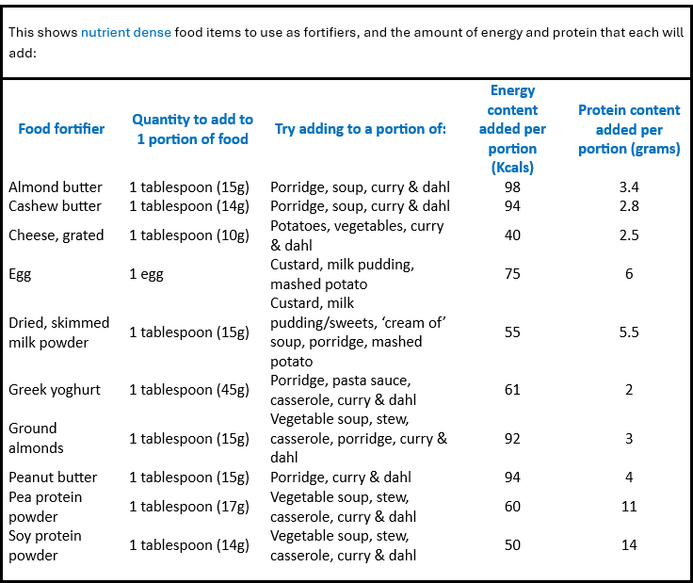


Food Fortification Examples
Food Fortification Examples

Slide 8
Fortification top tips:
Identify which foods/drinks the person likes and eats well & identify the best ingredient(s) to use to fortify that food or drink
Use nutrient dense ingredients to fortify food. Cream and butter can make foods taste nice, however because they only contain calories with no protein and very few vitamins/minerals - extra cream/butter should not be used to fortify foods
Use the stated amount of the fortifier per portion
Ensure the food still tastes good after fortification (try the food before serving it)
Ensure that the person is also encouraged to take 2 - 3 between-meal snacks every day
Use fortified milk for all residents who are at medium or high risk of malnutrition. Make fortified milk by mixing 4 tablespoons skimmed milk powder into each pint of full milk and use in hot drinks, on cereal and in cooking
Notes:
2nd bullet point – Jacket potato example (add butter and cheese)

Slide 9

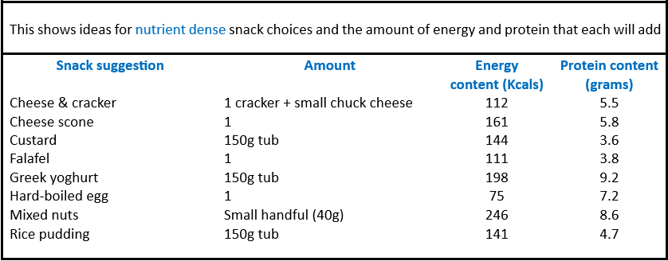

Nutritious Snack Examples

Slide 10
Nourishing fluids
Fluids are important for maintaining optimum bodily function and preventing ill health
Although fluids can be filling which can impact on appetite, they can also provide an opportunity to improve nutritional status when oral intake of foods is minimal e.g. offering A Glass of whole milk instead of water
Try to choose some nutrient dense drinks from the list on the next slide, in place of lower energy choices like water, tea, sugar free soft drinks such as squash or fizzy drinks
Further detailed information on general hydration guidance is covered in topic 6

Slide 11
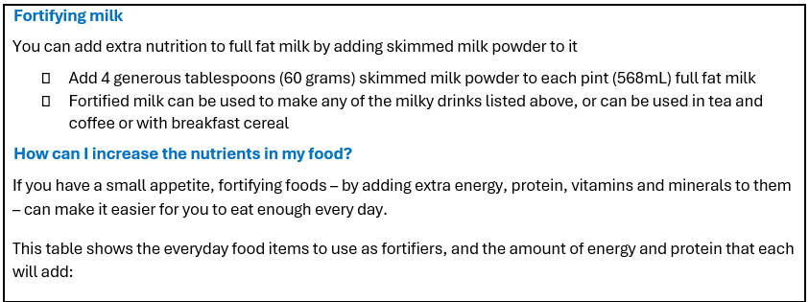

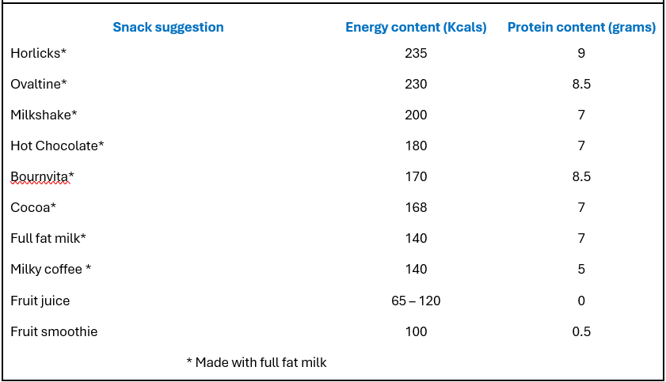

Nourishing Fluid Examples

Slide 12
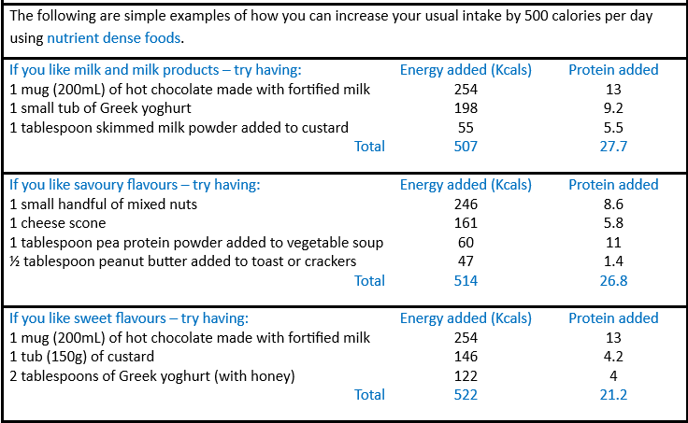

Examples of nutrient dense foods added across the day

Slide 13
Other considerations:
Texture modified diet and fluids
Always follow speech and language therapists’ (SLT) recommendations in line with IDDSI considerations
Residents who have dysphagia are excluded from the new care home pathway/scheme. This is mentioned in TOPIC 5.
Cultural
Always ensure food fortification considers cultural preferences
Allergens/ Intolerances
Always ensure these are clearly documented and followed when fortifying foods

Slide 14
General Tips for increasing food intake
Smaller meals but more frequently throughout the day
Nourishing snacks and drinks between meals
Ensure the environment where meals are eaten is calm and peaceful
Make foods look attractive - garnish food with parsley, lemon or tomatoes
Sharp tasting foods are refreshing. Try fresh fruit, fruit juices, lemon squash or boiled sweets
An alcoholic drink if permitted by the doctor, before a meal can help to stimulate appetite

Slide 15
Tips to ensure a good dining environment:
Minimise distractions
Adequate lighting- appropriate lighting can help in seeing and recognizing foods offered, making it much easier to eat
Make food the focus
Eat meals with others- keep the patient centred; this could be in a large dining area with others or eating in a quiet environment with 1-2 others that the individual feels comfortable
Serve meals and snacks at the same times each day- consistency helps establish a routine and this may help improve intake
Ensure appropriate food options are readily available if patients miss a meal or snack if they have been asleep or away at mealtimes
These adaptations can be supportive for those with visual impairments, cognitive decline e.g., dementia/post –stroke or when generally unwell and appetite is reduced
Please see Dementia UK Eating and Drinking guide
And
Care Home Digest - BDA

Slide 16
Homemade ONS Replacement Supplements
To be used for all residents with a MUST score of 2+
  - (Except those residents who meet the exclusion criteria)
2 portions to be offered per day
5 different recipes available to suit different tastes/dietary requirements (see next slide for details)
Please ensure you follow the recipes as they are written (using the exact products and quantities stated) as other milkshake flavourings /hot drink powders /fruit juices do not contain the same vitamins & minerals
These recipes are available on the following links:
LSCDG Providing care website APC website.

Slide 17
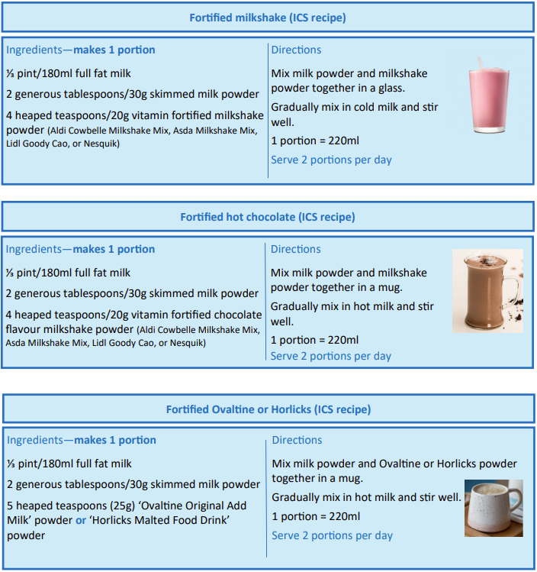
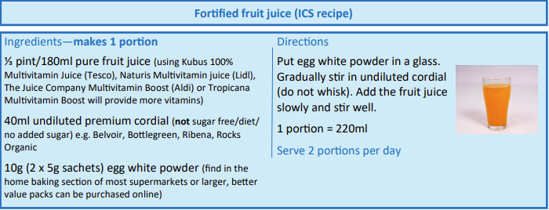
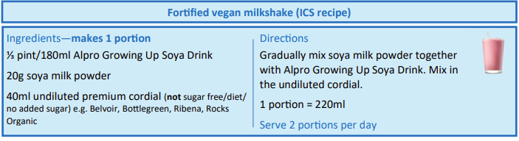
Homemade ONS replacement
Supplement Recipes

Slide 18




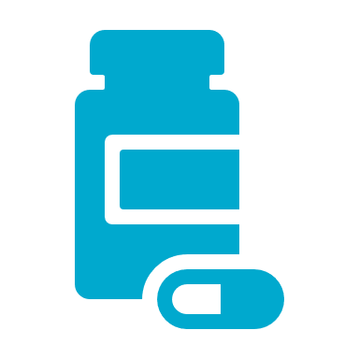
Home-made Supplement Drinks Tips
Home-made supplements can be made in batches of multiple portions.
Home made supplements can be stored in the fridge for up to 24hrs, and outside of the fridge for 4 hours as per Food Standards Agency guidance
It is important you only use the ingredients listed, as this ensures they are providing the correct nutrition
If your resident is unable to consume the home made supplements or experiences any other problems, we have a range of resources or you can contact our dietetic department
Remember these home-made supplements are only intended for residents identified at high risk of Malnutrition (MUST 2 or above) who would have previously been prescribed an oral nutritional supplement

Slide 19
Use of Prescribed Oral Nutritional Supplement (ONS) in Care Homes
From 1st September 2025:
Leicester, Leicestershire and Rutland (LLR) ICB does not support the use of prescribed ONS for care home residents. Food-based interventions (which contain a similar range of nutrients) should be provided for residents by care homes instead
Please see any of the links below for details of the full pathway:
    LSCDG Website Providing care website APC website.

Slide 20
Prescribed Oral Nutritional Supplements
(ONS)
A clinical assessment may indicate that there are some exceptional circumstances where residents may need to be on prescribed ONS under guidance from a Dietitian.
Clear rationale will be needed as to why the homemade ONS replacement drinks may not be appropriate, in line with the LLR Care Home Malnutrition Management Pathway.
A Dietitian will choose the most appropriate type of ONS dependent on the patient’s need.
ONS come in a variety of forms e.g. powdered, pre-mixed milkshake, juice style, desserts style, small volume, modified thickness.

Slide 21

Key considerations when using prescribed ONS
ONS may only be prescribed when:
A resident meets the exclusion criteria with clear rationale as to why homemade ONS replacement drinks are not suitable.
Flavour fatigue can affect compliance, therefore flavours should be varied
Standard ONS can be offered chilled or warm, however this may alter the thickness or IDDSI level of the drink.
If specific IDDSI fluid levels in place, this may not be appropriate. Please seek guidance from Speech and Language therapy (SLT) if you have any concerns regarding a resident’s fluid and swallow status
They should not be used on a long term basis without regular monitoring and re-assessment
Prescribing of ONS are based on addressing specific dietary needs following individual patient’s dietetic assessment therefore they should ONLY be given to that individual
If a resident has dysphagia, they will need a specialist thickened ONS, and therefore will need a referral to Dietitian.
Supplements should be taken after or between meals
Remember: even if a patient is taking supplements, food based treatment is still of benefit and should be continued. Prescribed supplements do not replace food.

Slide 22

Knowledge Check:
Please see Ethel’s diet below, consider how you could fortify her current diet. Also think about what other factors are important to optimise oral intake?
Breakfast:
Weetabix made with whole milk
Toast with butter
Cup of Tea with 1 x sugar and whole milk
Mid morning:
2x rich tea biscuits
200mls Cup of Tea (as above)
Lunch:
Chicken pie, mashed potato and mixed veg
Dessert: 1x bowl of rice pudding
150mls water
Mid afternoon:
A slice of fruit cake
200mls Cup of Tea (as above)
Evening Meal:
1 slice of bread and butter, 1 bowl of veg soup
Dessert: 2x scoops of ice cream
150mls of squash
Evening snack:
200mls hot chocolate
Ethel’s meals are served in her bedroom, in front of the TV.

Slide 23
Food fortification ideas to encourage/offer Ethel
Breakfast:
Cereal: Use enriched milk/add 1-2 tablespoons greek yogurt
Toast: Add extra thick spread of butter/encourage other toppings e.g. peanut butter
Lunch/Evening meal:
Soup: Add cheese/ Greek yogurt/ skimmed milk powder/ almond or cashew butter
Chicken Pie: Add Greek yogurt and cheese to filling
Mash potato: Add skimmed milk powder, Greek yogurt or cheese
Veg: Add cheese sauce or cheese when serving
Snacks/Pudding:
Can we offer some custard/Greek yoghurt alongside fruitcake?
Would Ethel like some cheese and crackers instead of plain biscuits?
Fluids:
Tea: Ensure full fat milk used, add extra milk, sugar
Hot chocolate: add marshmallows, full fat milk
Offer variety of fluids- consider fresh juice/home made milkshakes/smoothies as an alternative?
Environment:
Consider if Ethel eats better with others?
Is there adequate lighting?
Are there any distractions?
Is the temperature of the food appropriate ?

Slide 24
Summary
Food based treatment can help to provide extra protein to promote wound healing, increase muscle strength, improve mobility, reduce risk of infections. They also help to provide extra energy (calories) to promote weight gain and helps the body to use protein effectively.
Although fluids can be filling which can impact on appetite, they can also provide an opportunity to improve nutritional status when oral intake of foods is minimal.
ONS should only be prescribed when a resident meets the exclusion criteria with clear rationale as to why homemade ONS replacement drinks are not suitable. They should not be used on a long term basis without regular monitoring and re-assessment.
Always be mindful of the suitability of foods used to enrich a patient’s diet if they
- are on a texture or fluid modified diet
- have specific cultural or dietary preferences
- have allergies/intolerances which may require special considerations.
Treating malnutrition also includes ensuring a nutrient dense diet, adequate fluid intake as well as a suitable environment to optimise oral intake and support health and wellbeing.

