Slide 1

Improving Community Adult Nutrition (I-CAN) e-learning
RECAP:In Topic 4 Treatment and Prevention of Malnutrition, we covered:
Food based treatment can help to provide extra protein to promote wound healing, increase muscle strength, improve mobility, reduce risk of infections. They also help to provide extra energy (calories) to promote weight gain and helps the body to use protein effectively.
Although fluids can be filling which can impact on appetite, they can also provide an opportunity to improve nutritional status when oral intake of foods is minimal.
ONS should only be prescribed when a resident meets the exclusion criteria with clear rationale as to why homemade ONS replacement drinks are not suitable. They should not be used on a long-term basis without regular monitoring and re-assessment.
Always be mindful of the suitability of foods used to enrich a patient’s diet if they
- are on a texture or fluid modified diet
- have specific cultural or dietary preferences
- have allergies/intolerances which may require special considerations.
Treating malnutrition also includes ensuring a nutrient dense diet and adequate fluid intake, as well as a suitable environment to optimise oral intake and support health and wellbeing.
Leicestershire
Nutrition & Dietetic Service

Slide 2

I-CAN – Monitoring Guidance and Next Steps
Please DO NOT save or share this PowerPoint to avoid circulation of out of date information
Leicestershire
Nutrition & Dietetic Service

Slide 3

Aims:
Understand what factors to monitor in line with patient’s nutritional care plan
Learn how to adequately complete food and fluid charts
Learn how to evaluate information obtained when reviewing nutritional care plan and what actions to take next
When to contact and refer to the Dietitians
How to refer to the Dietitians

Slide 4
Monitoring:
Once the MUST management plan is in place, it is important to continue to monitor the patient. Below are key factors to monitor:
Repeat MUST screening as required
Review of nutritional care plan and compliance
Review food & fluid charts
Identify potential barriers that may affect the care plan put in place- e.g. poor skin integrity, environment, infection status, mood, bowels
Ensure record keeping is timely and accurate
If MUST score reduces to 0 (low risk of malnutrition) food and fluid charts can be stopped.

Slide 5
Food and Fluid record charts
These can be used as a tool to clearly show what a patient has been offered to eat and drink over a period of time, and how much of this has been consumed.
It should be used for management plan of MUST score 1 and above.
What should it include?
All food and drinks offered throughout the day
Amount taken/declined i.e. (eaten half of main and all dessert)
Any additional fortification added to food or drinks (i.e. fortified with dried skimmed milk powder and 2 tablespoons of Greek yoghurt)
Foods brought by family/relatives or eating out
Any Homemade ONS replacement drinks (ICS recipes) or prescribed ONS. These will also be included on the medication (MARs) charts, but can also be added to the food and fluid charts.

Slide 6
What can food and fluid record charts tell us?
Helps to identify food preferences and trends with food intake e.g. eating patterns
Helps to identify window of opportunity on when to maximise nutritional intake e.g. preferred time of day
Helps to identify the resident’s preferred environment for having their food e.g. the resident eats better when in the dining room with others, therefore meals should be encouraged in the dining room
Aids communication between staff, relatives and health care professionals as it provides documented summary of oral intake

Slide 7
Evaluate what to do next?
If you have identified areas of concern when monitoring management plan in place, please consider the following next steps:
Act
Act on results e.g. increased MUST score
Inform
Inform senior staff
Follow Pathway
Refer to the Care Home Malnutrition Management Pathway (based on MUST) which will advise on which actions to take for your resident
Change
Change nutritional care plan- e.g. consider food based treatment or starting homemade ONS replacement drinks (as per LLR Malnutrition management in care homes pathway)
Monitor
Consider
Under certain circumstances, please consider if a referral to Dietetics may be required
Monitor progress with the plan

Slide 8
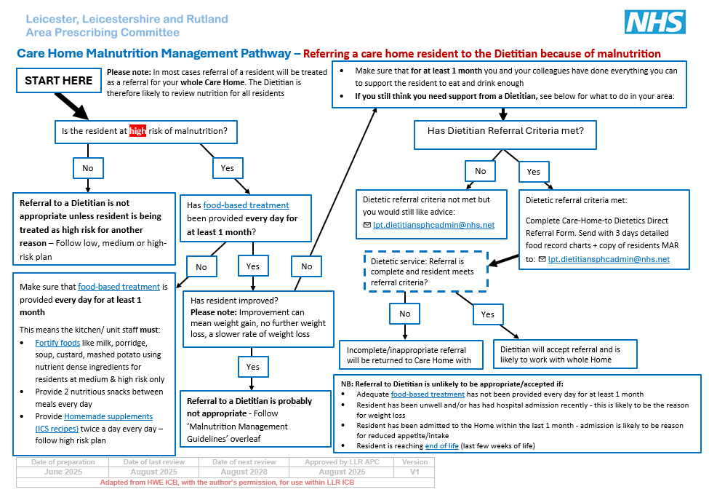
Here is an overview of the care home malnutrition management pathway.
This looks at when to refer a care home resident to the Dietitian because of malnutrition.
We will look at this in more detail over the next 6 slides.
Referral to Dietetics
More information about this scheme, can be found on the following websites:
LSCDG Providing care website APC website.

Slide 9
When to consider contacting the Dietitians?
There are three occasions when you may wish to contact the Dietitians for more guidance (each of these will be broken down and covered in more detail on the next slides) :
1
If exclusion criteria are met
2
If food based treatments and homemade ONS replacement drinks are in place, but the resident is not improving (MUST score of 2+)
3
Dietetic referral criteria is not met, but you would still like advice.

Slide 10
1. Exclusion criteria
If any of the criteria below are met, please refer to the Dietitians.
Tube fed residents
Resident will usually already be referred to Leicestershire Nutrition and Dietetics Home Enteral Tube Feeding Dietetic Team/ other Home Enteral Tube Feeding Dietetic Team if under out of area care.
Residents with Dysphagia
The resident has been diagnosed with swallowing difficulty (dysphagia) requiring thickened ONS and has been identified as malnourished using a validated screening tool (e.g., MUST).
Exceptional circumstances
In very exceptional circumstances where a clinical assessment indicates the need to consider alternative intervention to home-made nutritional supplements as part of a food-based approach, this must be decided on a case-by case basis with a clear rationale to justify recommended action plan and aims of treatment in supporting the resident to meeting their nutritional needs.

Slide 11
2. Resident is not showing signs of improvement
If you have a resident who:
      Is at High risk malnutrition (MUST score 2+)
      Has had Food based treatments in place everyday for at least 1 month.
      (This means that:
      -Foods have been fortified
      -2 nutritious snacks have been provided everyday between meals
      -2 homemade ONS replacement drinks (ICS recipes) have been provided everyday)
      3. And there are still no signs of improvement
Please refer to the Dietitians via direct care home to Dietetics referral form.

Slide 12

3. Would like advice
If the Dietetic referral criteria is not met but you would like advice about your resident in relation to the scheme, please fill in a referral form for the resident. Use section 4 of the referral form to clearly outline your query. It may mean that the resident needs a one-off appointment with a Dietitian to discuss the query.
Please email your referral form to:
  lpt.dietitiansphcadmin@nhs.net

Slide 13
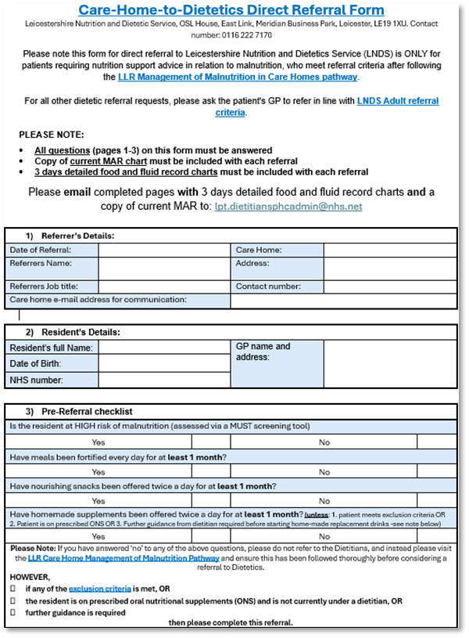
Dietetic Referral Form
We now have a Care-Home-to Dietetics Direct Referral Form available for all residents who require nutrition support advice in relation to malnutrition.
Please ensure:
- All Questions/sections are completed
- Attach 3 days of detailed food and fluid charts for the resident
- Attach a copy of the residents MARS chart
Please send all referrals to: lpt.dietitiansphcadmin@nhs.net
Please be aware that all other referrals for care home residents that are not for nutrition support advice in relation to malnutrition, will need to be sent via the GP.

Slide 14
A Dietetic referral is not likely to be appropriate/accepted if:
Adequate food-based treatment has not been provided every day for at least 1 month (and there is no evidence of this on the food charts)
Resident has been unwell and/or has had hospital admission recently - this is likely to be the reason for weight loss
Resident has been admitted to the Home within the last 1 month - admission is likely to be reason for reduced appetite/intake
Resident is reaching end of life (last few weeks of life)
However, if the exclusion criteria is met OR the resident is on prescribed oral nutritional supplements (ONS) and is not currently under a dietitian, then a referral would be accepted in those circumstances.

Slide 15
Knowledge check:
Ethel previously had a MUST score of 1.
Since then, Ethel’s intake has decreased further due to the side effects of the antibiotics she is taking for her chest infection.
Weight is checked and she is now 56.5kg (further loss of 1.5kg).
BMI 24.5kg/m2, 10.3% weight loss in the last 3-6 months
MUST = 2.
Question: What would you monitor and evaluate?
Monitoring guidance
Repeat MUST screening- Has MUST score changed?
Review of nutritional care plan- Is the current plan still appropriate?
Review food & fluid charts- Does this need to continue?
Identify potential barriers- Reflect on changes made to overcome any potential barriers and how might these strategies be used in the future
Evaluation guidance
Nutrition management plan going forward should be inline with updated MUST score

Slide 16
Summary
The importance of repeating MUST screening, ongoing use of food record charts where appropriate, identifying barriers to a care plans and reviewing nutritional care plan and compliance
The importance of Food and fluid charts and how to complete these
The evaluation of care plans
When to contact and refer to the Dietitians
How to refer to the Dietitians

