Slide 1

Improving Community Adult Nutrition (I-CAN) e-learning
RECAP: In Topic 5 Monitoring Guidance and next steps, we covered:
The importance of repeating MUST screening, ongoing use food record charts where appropriate, identifying barriers to a care plan and reviewing nutritional care plan and compliance
Referring to a GP if a resident has a MUST score of 2 and above or food first has been implemented and weight loss has continued.
Food and fluid charts should contain all food and drink offered, what was eaten or declined, if the meal was fortified and how, if family supported with meal-time and include details of prescribed supplements consumed
Food and fluid charts can tell us about someone’s food preferences, what creates the best environment to promote eating and drinking, and if there are times of day/night eating and drinking improves.
Leicestershire
Nutrition & Dietetic Service

Slide 2


I-CAN - Additional KEY factors that influence nutritional care
Please DO NOT save or share this PowerPoint to avoid circulation of out of date information

Slide 3
The aims of this PowerPoint is to highlight some of the additional factors that influence nutritional care:
Fluid requirements for adequate hydration
Nutrition for South Asian Diet and African and Caribbean Diet
Oral health/Dentition
Allergies
Bowel Health
Skin Health
Useful Links- LNDS, LLRAPC, Dietetic Referral Criteria etc

Slide 4

Adequate fluids:
Benefits of good hydration
Implication of dehydration
Causes of dehydration
Signs of dehydration

Slide 5


Benefits of good hydration
Good hydration is one of the most important aspects of the diet – drinking enough liquids to keep the fluid levels in the body topped up helps to ensure that all bodily functions are able to take place as normal.

Slide 6
Hydration levels can impact on the following: f dehydration
Constipation
Urine infections
Low blood pressure
Mental function
Falls
Increased risk of hospital admissions

Slide 7
Causes of dehydration
Vomiting
More fluid is lost due to …
Confusion or memory loss
Nausea
Pressure sores
Intake of fluid is reduced by …
Diarrhoea
Poor mobility
Fever
Drinks out of reach
Fluid requirements are increased by…
Hot weather
Notes:
Cognitive impairment
Changes in functional ability
Medication e.g. laxatives, diuretics
Illness
Stress arising from other factors
Reduced sense of thirst
Decreased kidney function
Reduce fluid intake to avoid visits to the toilet
Dementia – forget to drink or think they have drunk
Reduced social contact reduces social drinks

Slide 8
Some signs of dehydration
Dark and strong-smelling urine (Key indicator)
Urinating fewer than 4 times a day
Irritable and tired
Feeling dizzy or light-headed
Headache
Confusion or mood change
Dry mouth, lips and eyes
Feeling thirsty

Slide 9
General guide to fluid requirements
According to the national Eatwell guide, general fluid intake should be around 6-8 cups or glasses per day
Some foods have higher fluid content for example fruits such as melon, yoghurts, soup, milk added to cereal and can help contribute towards fluid intake
Please click here for more information on the ideal colour for urine
Notes:
Is this realistic in care homes?

Slide 10
Sources of fluids
80% of water comes from drinks, 20% is in food
Helping patients drink well
Give extra fluid with medication
Drinks can include any fluids excluding alcohol
Sauces, soup, gravy, milky puddings, custard, yoghurts, fruits and vegetables
Find out when and how they like to drink
right temperature, variety, brand
Encourage, support, accessibility to drinks
Drinking is part of socialising time
Identify residents at risk of dehydration or those that require assistance and monitor and record their fluid intake

Slide 11
Skin Health
Those with pressure sores/ulcers should have a nutritional care plan which is focused on adequate energy, protein and a nutrient dense diet to protect their skin from deteriorating, and promote wound healing. The patients should be referred to a tissue viability nurse for support. Please see BDA factsheet on Pressure Injuries for more information.
Allergies
Should be clearly documented and all efforts should be made to ensure an appropriate nutritionally complete diet is provided with suitable alternatives.
Oral Health/Dentition
Good oral health/appropriate dentition is important to ensure good nutritional oral intake. Always seek support from GP and/or dentist at earliest signs of possible dentition concerns. E.g. if patient suffers from dry mouth, a GP may provide artificial saliva to help improve patients’ oral intake.

Slide 12
Bowels
Constipation and/or diarrhoea can impact on nutritional status. It is important to reflect on patients’ current oral intake. This can be done by monitoring food/fluid charts as well as reviewing whether change in medication has had an impact on their bowels and seek advice appropriately.
Bristol Stool Chart provides a good visual when documenting bowel movements and is a good indicator for identifying any bowel issues.
Increase in fluids can improve symptoms of constipation and prevent dehydration caused by diarrhoea. However, if increase in fluids changes do not improve symptoms, then seek advice from GP.

Slide 13
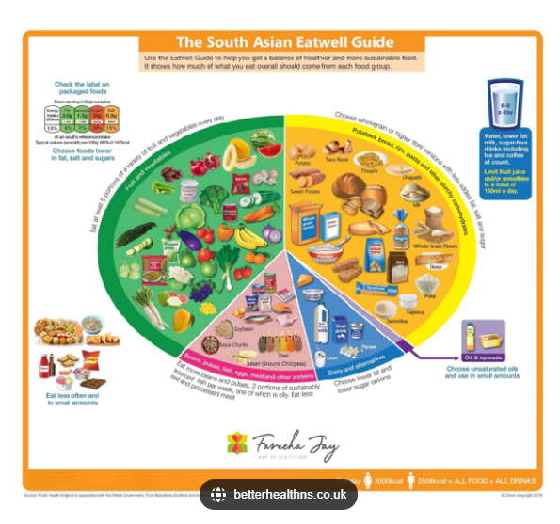
Nutrition for South Asian Diet
Click here to find out more information on each food group

Slide 14
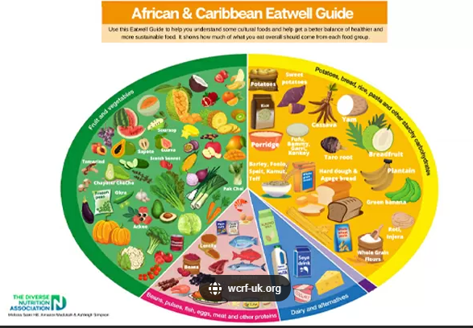
Nutrition for African and Caribbean Diet
Click here to find out more information on each food group

Slide 15
Useful Links
Please also see the ‘I-CAN-e-learning Reference Sheet’ on our LNDS Website for all links included within PowerPoints 1-6
Leicestershire Nutrition and Dietetic Service (LNDS) website:
Provides a range of dietary resources to support general health and different conditions.
List of contact details
- Referral criteria
British Dietetic Association (BDA) website:
Provides a range of resources for adults and older adults, see Food Fact sheets
Managing Malnutrition: Leaflets for Patients and Carers (malnutritionpathway.co.uk)
British Association for Parenteral and Enteral Nutrition (BAPEN) website for MUST information and tools
Leicester, Leicestershire and Rutland Area Prescribing Committee (LLRAPC) ‘Managing Malnutrition in Adults in Primary Care’ guidelines.
Providing Care website- Nutrition

Slide 16
Summary
It is time to check your knowledge on nutrition and hydration for adults in community settings to ensure that you are confident with applying your learning in your work setting.
Please complete the overall knowledge check assessment in order to receive your certificate.
This is a set of multiple choice questions which will ensure that you have learnt and understood the key factors to support your patients
This assessment also includes some questions on evaluating your learning from this training course.
This questionnaire can be accessed directly from our website where the training course material is located.

