Slide 1

Improving Community Adult Nutrition (I-CAN) e-learning
RECAP: In Topic 5 Monitoring Guidance and next steps, we covered:
The importance of repeating MUST screening, ongoing use of food record charts where appropriate, identifying barriers to a care plan and reviewing nutritional care plan and compliance
When to contact and refer to the Dietitians
The importance of Food and fluid charts and how to complete these
The evaluation of care plans
How to refer to the Dietitians
Leicestershire
Nutrition & Dietetic Service

Slide 2


I-CAN - Additional KEY factors that influence nutritional care
Please DO NOT save or share this PowerPoint to avoid circulation of out of date information
Leicestershire
Nutrition & Dietetic Service

Slide 3

Aims:
The aim of this PowerPoint is to highlight some of the additional factors that influence nutritional care:
Fluid requirements for adequate hydration
Nutrition for South Asian Diet and African and Caribbean Diet
Oral health/Dentition
Allergies
Bowel Health
Skin Health
Useful Links for reference

Slide 4


Benefits of good hydration
Good hydration is one of the most important aspects of the diet – drinking enough liquids to keep the fluid levels in the body topped up helps to ensure that all bodily functions are able to take place as normal.

Slide 5
Causes of dehydration
Fluid requirements are increased by…
Hot Weather
Fever
Intake of fluid is reduced by …
Poor mobility
Drinks out of reach
Nausea
More fluid is lost due to …
Vomiting
Diarrhoea
Pressure sores
Confusion or memory loss
Reduced sense of thirst
Swallowing difficulties

Slide 6
Consequences of Dehydration:
Constipation
Urinary tract infections
Low blood pressure
Mental function
Falls
Increased risk of hospital admissions
Kidney failure
Poor wound healing
Pressure injury

Slide 7
Screening for Dehydration
There is no reliable assessment or screening tool to identify dehydration (Care Home Digest – BDA)
Instead, it is best to rely on having a good understanding of the signs of dehydration and knowing how much fluid a person needs as a general rule.

Slide 8
Some signs of dehydration
Dark and strong-smelling urine (Key indicator)
Urinating fewer than 4 times a day
Irritable and tired
Feeling dizzy or light-headed
Headache
Confusion or mood change
Dry mouth, lips and eyes
Feeling thirsty

Slide 9
General guide to fluid requirements
Some foods have higher fluid content for example fruits such as melon, yoghurts, soup, milk added to cereal and can help contribute towards fluid intake
Please click here for more information on the ideal colour for urine
As a general rule older women need to drink at least 1,600ml fluid per day and older men need at least 2,000ml fluid per day
Notes:
Is this realistic in care homes?

Slide 10
Sources of fluids
80% of water comes from drinks, 20% is in food
Sauces, soup, gravy, milky puddings, custard, yoghurts, fruits and vegetables
All fluids count towards meeting hydration needs including drinks containing caffeine and low alcohol drinks up to 4% alcohol by volume (ABV) (within recommended limits)
Every sip of fluid matters and residents do not have to be encouraged to only drink water if they prefer other drinks.
For residents who are malnourished the focus should be on drinks which also provide nutrition e.g., whole milk, milkshakes and hot milky drinks e.g., hot chocolate, malted milk and milky coffee.

Slide 11
Helping patients drink well
(Taken from BDA Care Home Digest)
Availability of drinks:
Drinks should be available everywhere, at all times, at the right temperature and of the right type. There should always be a range of options that meet all needs and preferences
Opportunistic drinks:
When medications are provided, a full glass of fluid should be given, rather than just a few sips
Accessibility:
Help and support to access a drink and whilst drinking should be provided. This may mean using adapted drinking cups/glasses which meet residents’ needs. Health professionals (such as Speech and Language Therapists or Occupational Therapists) may be able to advise on these
Social interaction:
Drinking with others can encourage fluid intake
Cup and glass sizes:
Carers should know the volume of all commonly used cups, mugs and glasses within their care home and how that relates to the amount that residents need to be encouraged to drink each day
Preferences :
Try to make the drink look appealing and recognisable to encourage intake
Find out when and how they like to drink (e.g. right temperature, variety, brand)
Reassurance:
Residents may need to be discreetly reminded that there is support if fear of incontinence is a barrier to drinking well
Identify and Education:
Identify residents at risk of dehydration or those that require assistance and monitor and record their fluid intake
Supporting the resident, relatives and carers to understand the importance of drinking regularly.

Slide 12
Skin Health
Those with pressure injuries (previously known as pressure ulcers, pressure sores and bedsores) should have a nutritional care plan which is focused on adequate energy, protein and a nutrient dense diet to protect their skin from deteriorating and promote wound healing. The patients should be referred to a tissue viability nurse for support. Please see BDA factsheet on Pressure Injuries for more information.
Residents with a pressure injuries should be treated as Medium risk (Even if MUST score is 0)
Allergies
Should be clearly documented and all efforts should be made to ensure an appropriate nutritionally complete diet is provided with suitable alternatives.
Oral Health/Dentition
Good oral health/appropriate dentition is important to ensure good nutritional oral intake. Always seek support from GP and/or dentist at earliest signs of possible dentition concerns. E.g. if patient suffers from dry mouth, a GP may provide artificial saliva to help improve patients’ oral intake.

Slide 13
Bowels
Constipation and/or diarrhoea can impact on nutritional status. It is important to reflect on patients’ current oral intake. This can be done by monitoring food/fluid charts as well as reviewing whether change in medication has had an impact on their bowels and seek advice appropriately.
Bristol Stool Chart provides a good visual when documenting bowel movements and is a good indicator for identifying any bowel issues.
Increase in fluids can improve symptoms of constipation and prevent dehydration caused by diarrhoea. However, if increase in fluids does not improve symptoms, then seek advice from GP.

Slide 14
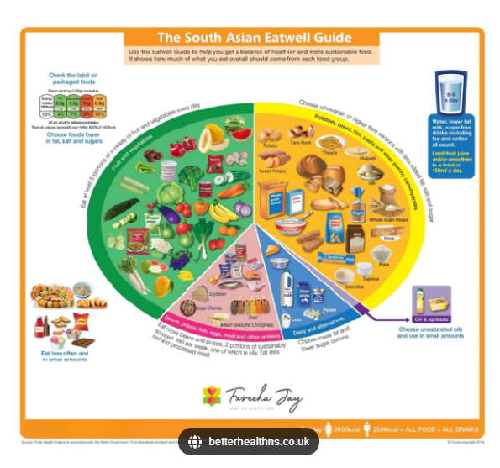
Nutrition for South Asian Diet
Click the picture to find out more information on each food group

Slide 15
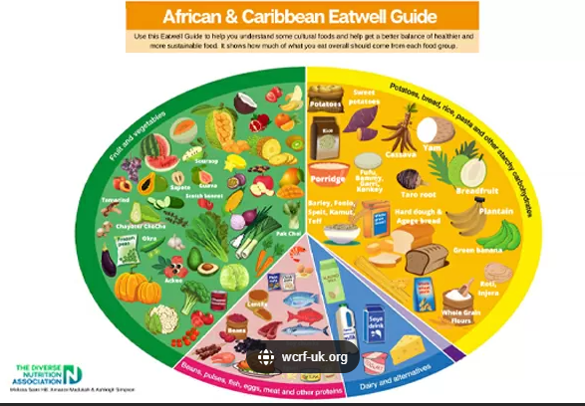
Nutrition for African and Caribbean Diet
Click the picture to find out more information on each food group

Slide 16
Useful Links
Leicestershire Nutrition and Dietetic Service (LNDS) website:
  Provides a range of dietary resources to support general health and different conditions.
  List of contact details
  Referral criteria
Leicester, Leicestershire and Rutland Area Prescribing Committee (LLRAPC) website:
  ONS replacement in care homes guidelines: ONS-Replacement-in-Care-Homes-Overarching-Document.pdf
  Malnutrition in adults guidelines: ‘Managing Malnutrition in Adults in Primary Care’
Providing Care website: Providing Care website- Nutrition
Care Home Digest – BDA
British Dietetic Association (BDA) website:
  Provides a range of resources for adults and older adults, see Food Fact sheets
  Managing Malnutrition: Leaflets for Patients and Carers (malnutritionpathway.co.uk)
  Care Home Digest – BDA (Some guidance was taken from this document throughout the 6 presentation topics)
British Association for Parenteral and Enteral Nutrition (BAPEN) website:
  - For MUST information and tools
Please also see the ‘I-CAN-e-learning Reference Sheet’ on our LNDS Website for all links included within PowerPoints 1-6

Slide 17
Summary
It is time to check your knowledge on nutrition and hydration for adults in community settings to ensure that you are confident with applying your learning in your work setting.
Please complete the overall knowledge check assessment in order to receive your certificate.
This is a set of multiple choice questions which will ensure that you have learnt and understood the key factors to support your patients
This assessment also includes some questions on evaluating your learning from this training course.
This questionnaire can be accessed directly from our website where the training course material is located.

